Slide 1


The Secure Electronic Health Records (SEHR)
Minor Project – 1
CY -
Problem Statement: The Secure Electronic Health Records (SEHR) project uses Ethereum blockchain to create a safe platform for managing patient health data. It lets patients control who can see their records, while doctors can easily access and share information, improving security and healthcare.
Project Group Number:
Group Member Details: 1. Shubham Rathor (0187CY221029)
2. Sambhav Mehara(0187CY221027)
3. Sumit Lodhi(0187CY221031)
Guide Details: Dr. Garima Mathur
(prof. Cyber-Security)

Slide 2
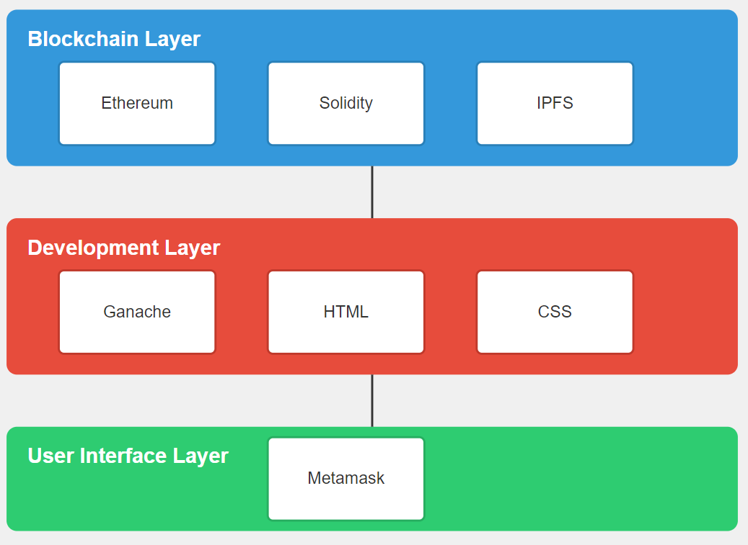
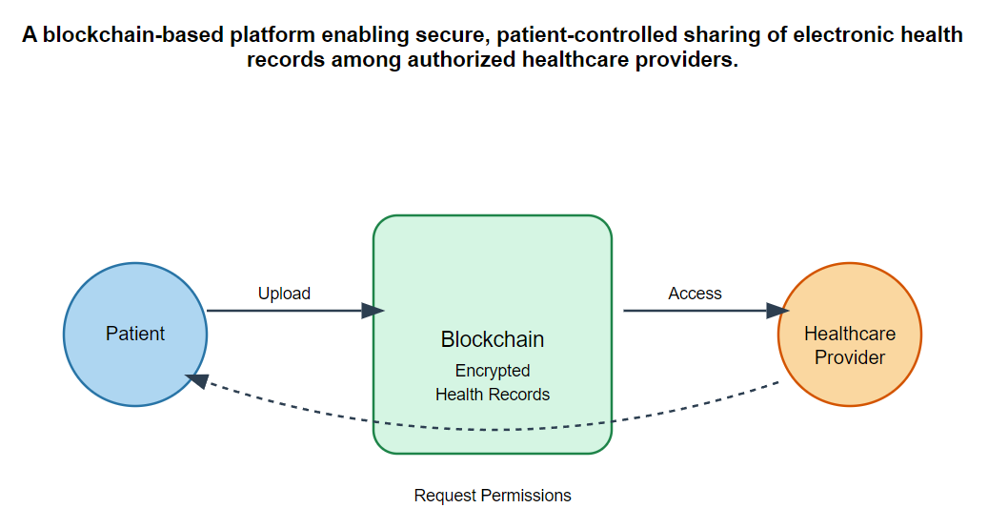
Idea/Approach Details
Abstract:
The "Secure Electronic Health Records" project uses Ethereum blockchain and IPFS to create a decentralized platform where patients can securely manage, store, and control access to their medical data, ensuring privacy, data integrity, and efficient healthcare collaboration.
Describe your idea Solution/Prototype here:
A decentralized platform leveraging Ethereum, and smart contracts to securely manage, share, and control access to electronic health records, enhancing patient privacy and data integrity.
Describe your Technology stack here:

Slide 3
Project Requirements
functional requirements
non functional requirements
)
Patient Management: Patients can upload, view, and manage their medical records.
Access Control: Patients can grant/revoke access to doctors and diagnostic centers.
Record Sharing: Authorized doctors and diagnostic centers can view and update patient records.
Data Storage: Medical records are stored securely using IPFS.
Smart Contracts: Manage permissions and record history on Ethereum.

Slide 4
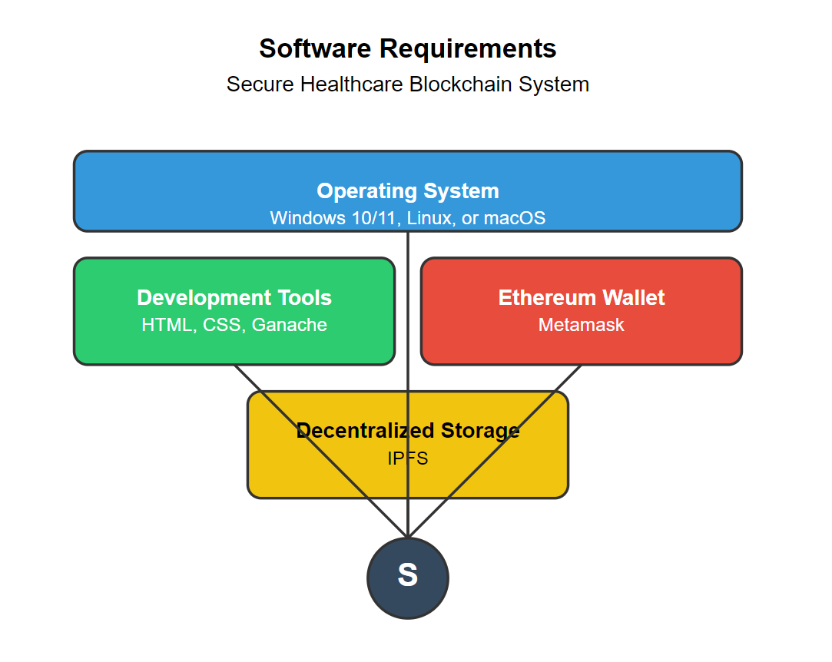
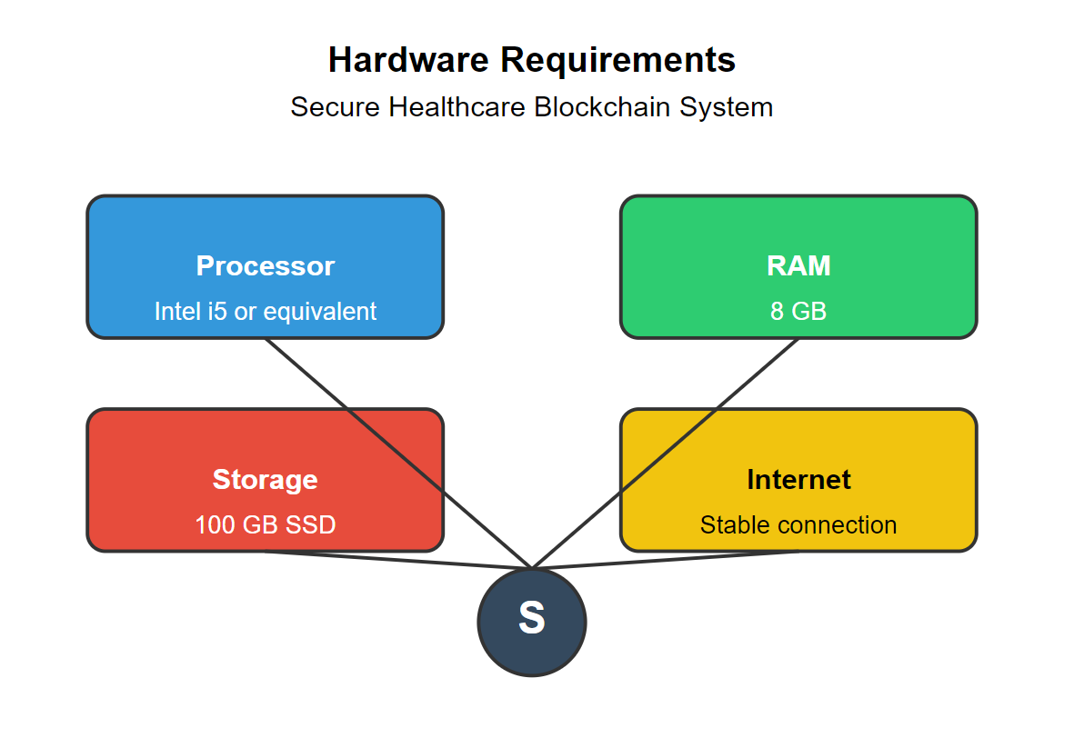
Project Requirements
hardware and software requirements
1. 2.

Slide 5

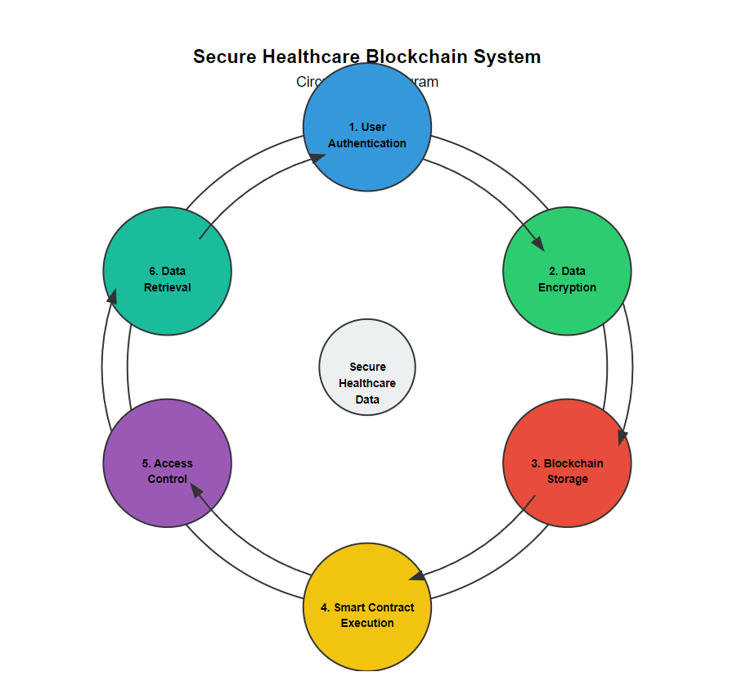
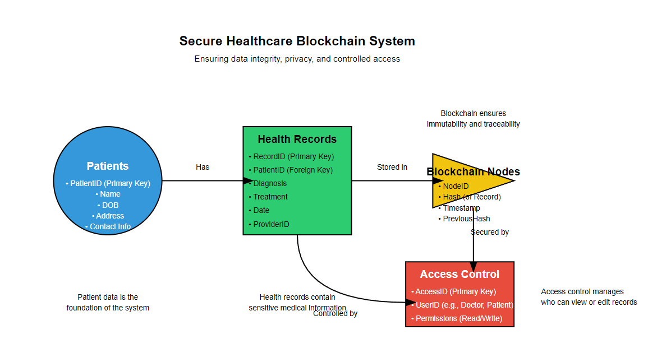
Design
Describe data flow diagram here(if applicable)
Describe your ER Diagram here(if applicable)

Slide 6
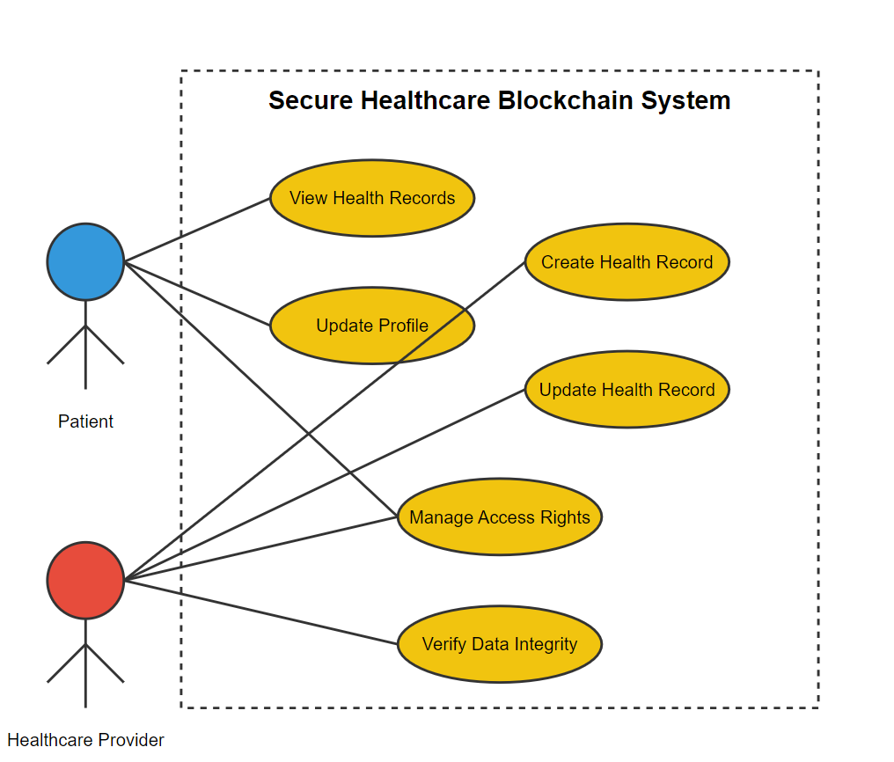
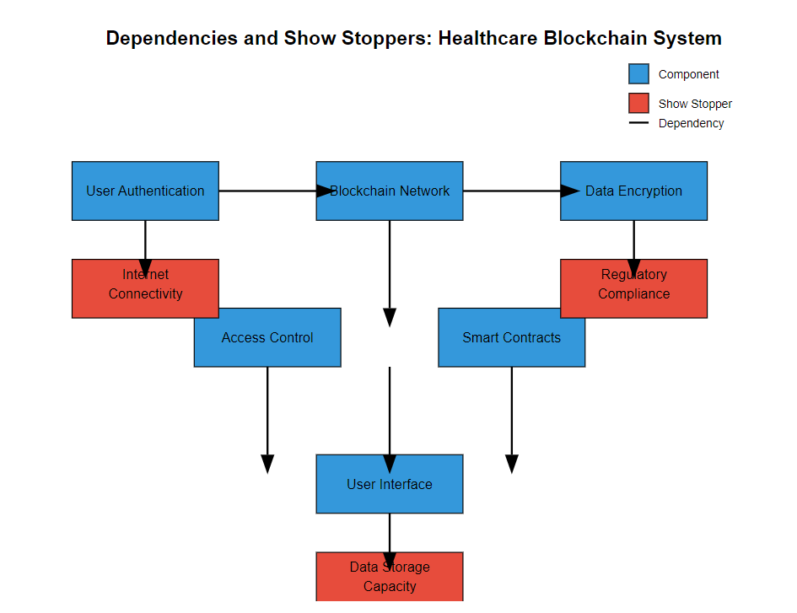
Design
Describe your Use Cases here
Describe your Dependencies / Show stopper here

Slide 7
Deployment Details
Describe Deployment Details here
NA

Slide 8
Monetary Support
financial requirements
NA

Slide 9
Project Screen shorts

Slide 10


Slide 11
Important Pointers
Please ensure below pointers are met while
Kindly keep the maximum slides limit to 10 pages
All the topics should be utilized for description of your idea
Try to avoid paragraphs and post your idea in points
Keep your explanation precisely and easy to understand
Delete Important Pointers slide After Creating a Presentation

